Slide 1


Alumni Connect

Slide 2
Who needs this?
Recent Alumni – Alumni of the college who have recently passed out of college (0-3 years) seeking guidance, mentorship or any kind of job opportunities.
Established Alumni – Alumni of the college who have passed out of the college (5+ years) who want to give back, share experiences and networking opportunities.
College Administration – Need to maintain engagement and success stories to build institutional reputation
Present students – Currently studying students for internship oppurtunites, career guidance and industry insight.

Slide 3
Why do we need this?
Alumni lose touch with college after graduation
Difficulty finding relevant mentors in a specific industry
No centralized platform for sharing to keep track of alumni achievements and engagement.
Current students lack direct access to college-level alumni in a centralized platform within the college.
What makes this stand out?
There are existing solutions in the form of LinkedIn and various other applications but this application here can provide:
A sense of belonging as it is a centralized college platform.
Like-minded Alumni could network for similar industry and companies.
They can explore the college feed as the college administration and students can post images of the college updates for the Alumni to view

Slide 4
Core features
Smart – profile creation
Event postings
LinkedIn style with career role tracking – where it shows which role the Alumni is working in and which company along with their experience
College administration and fellow Alumni can conduct webinars, meetups and networks to engage the Alumni and to stay in touch.
Industry-based mentorship
News Feed
Connect Alumni through desired industry, company or interests – like minded Alumni can connect after graduation with a sense of
The college administration or the present students can update the college feed for the Alumni to react and to stay in touch and to share their experiences – creating an interactive environment.
Success story hub
Giving back
Video testimonials, career journey articles, achievements. Alumni can share their achievements locally in the college platform for more exposure to the students and the college administration alike for networking.
Some Alumni would like to give back to the college, to perform donations or to provide mentorship as well as job opportunities

Slide 5
Workflow → Implementation
College
Admin
Students
Alumni
Welcome Screen → Dashboard (College Feed) → Profile management → Networking preferences → Mentorship/Job opportunities preferences → Success Story hub → Events feed
Browse Alumni → Filter by interested industry/company → Send request → Post college feed
Dashboard → Events feed → Browse Alumni → Update College Feed

Slide 6
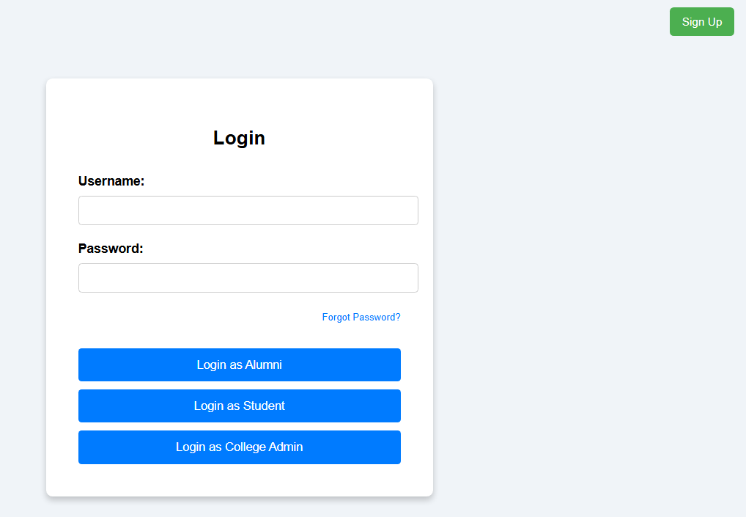
LOGIN

Slide 7
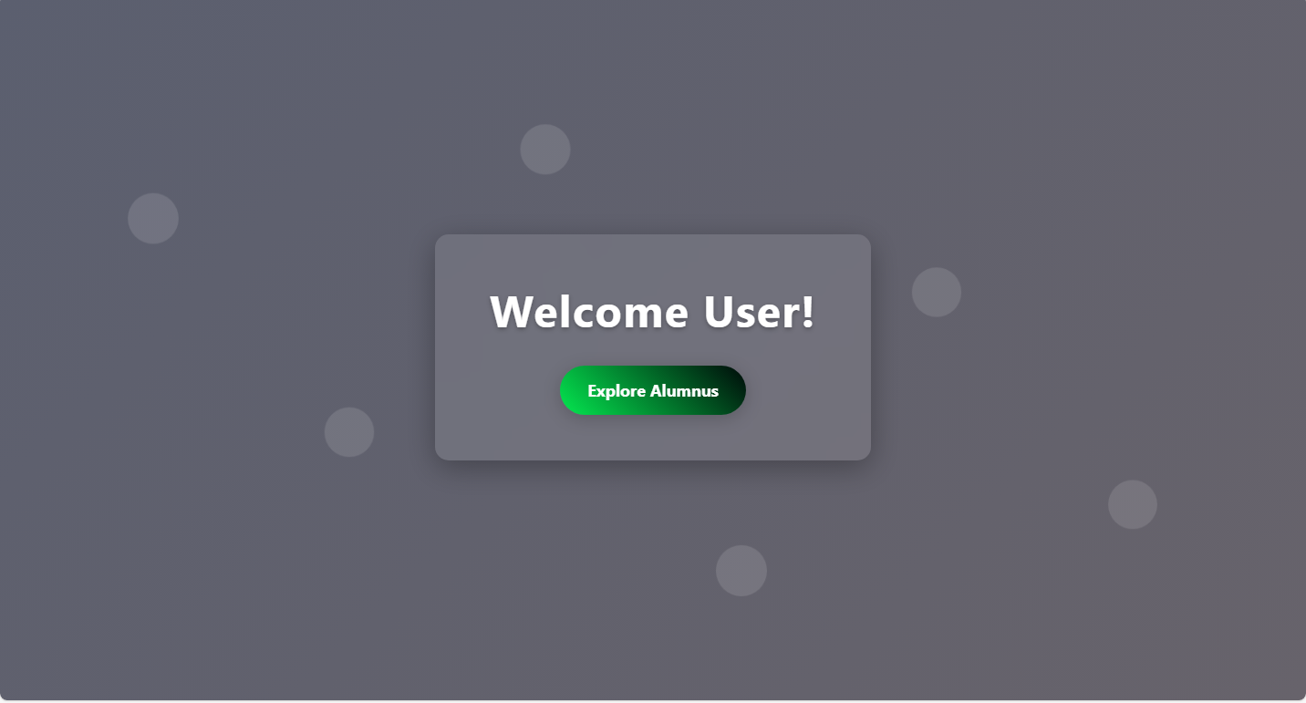
WELCOME DASHBOARD

Slide 8
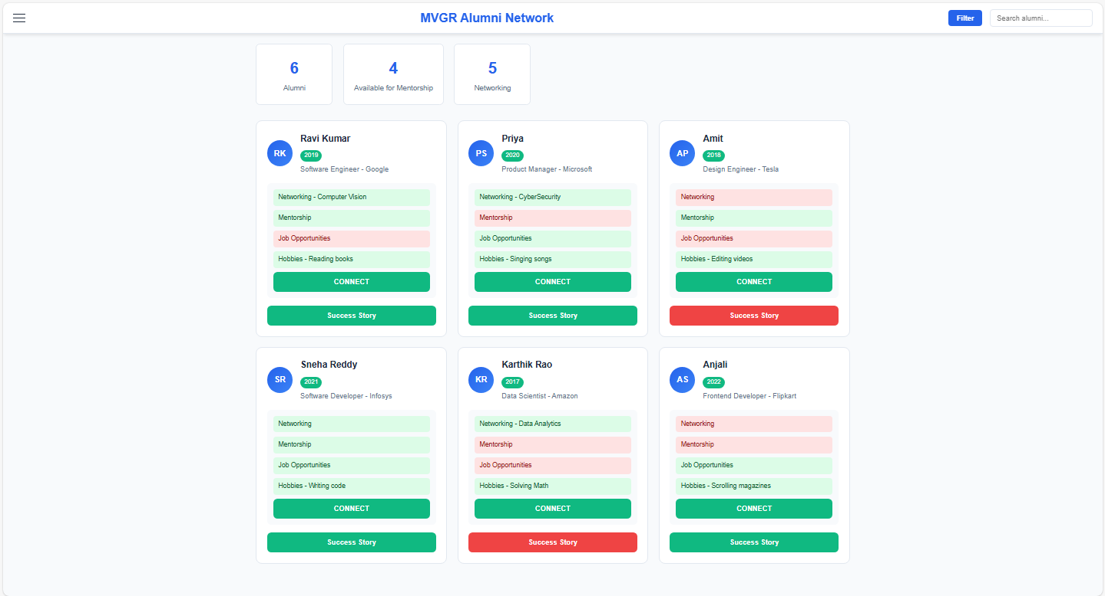
DASHBOARD

Slide 9
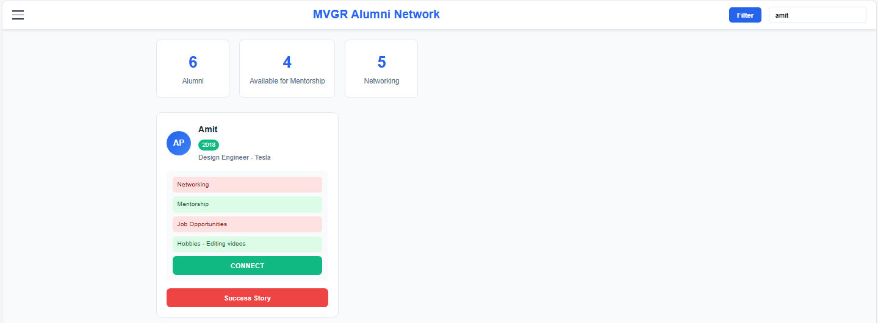
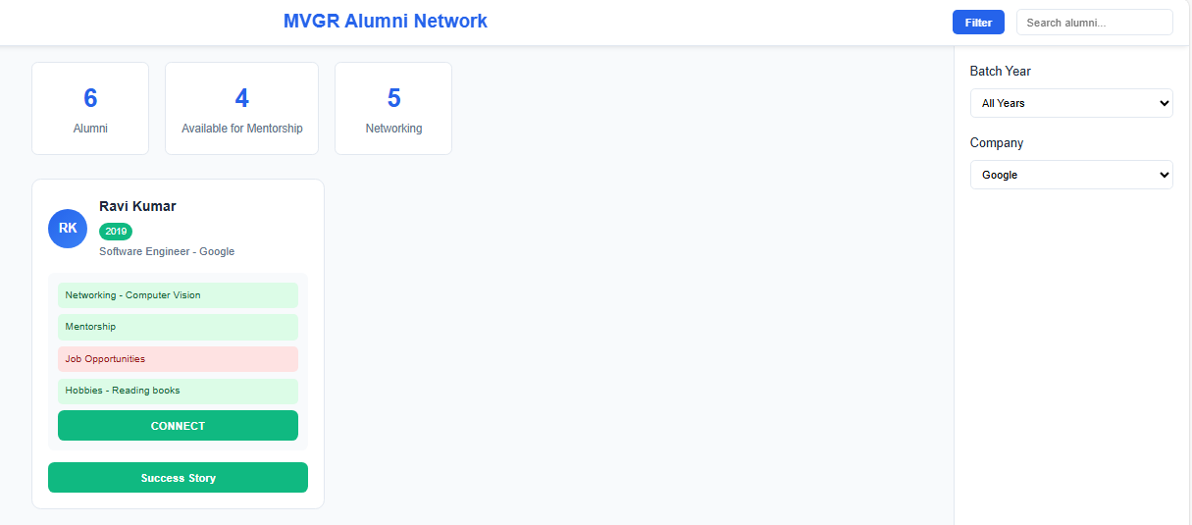
FILTERING

Slide 10
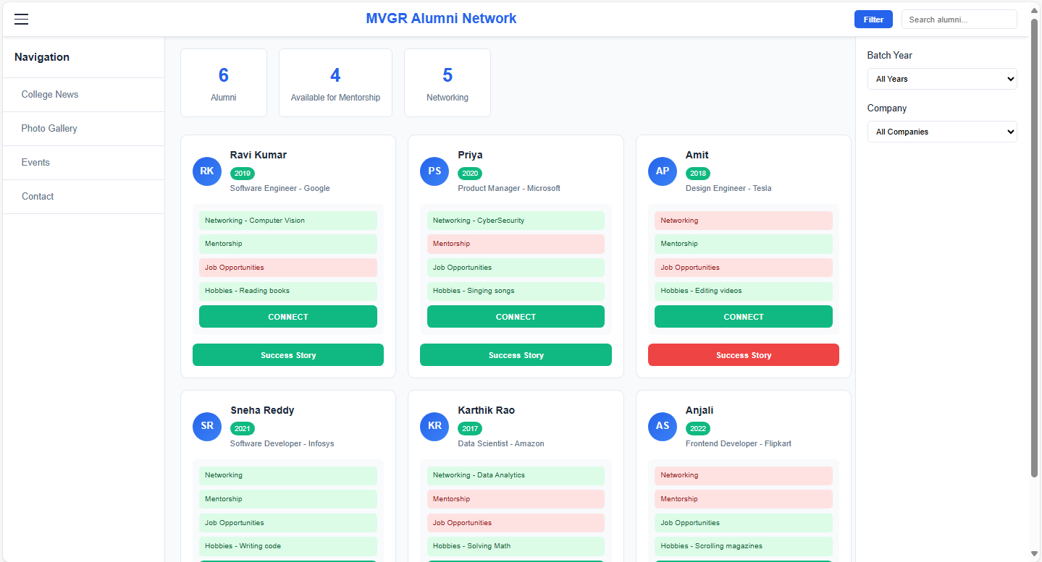
NAVIGATION

